Slide 1
Intelligent Trash Can

Slide 2
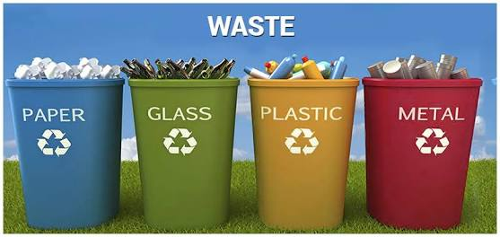
No time for segregating?

Slide 3
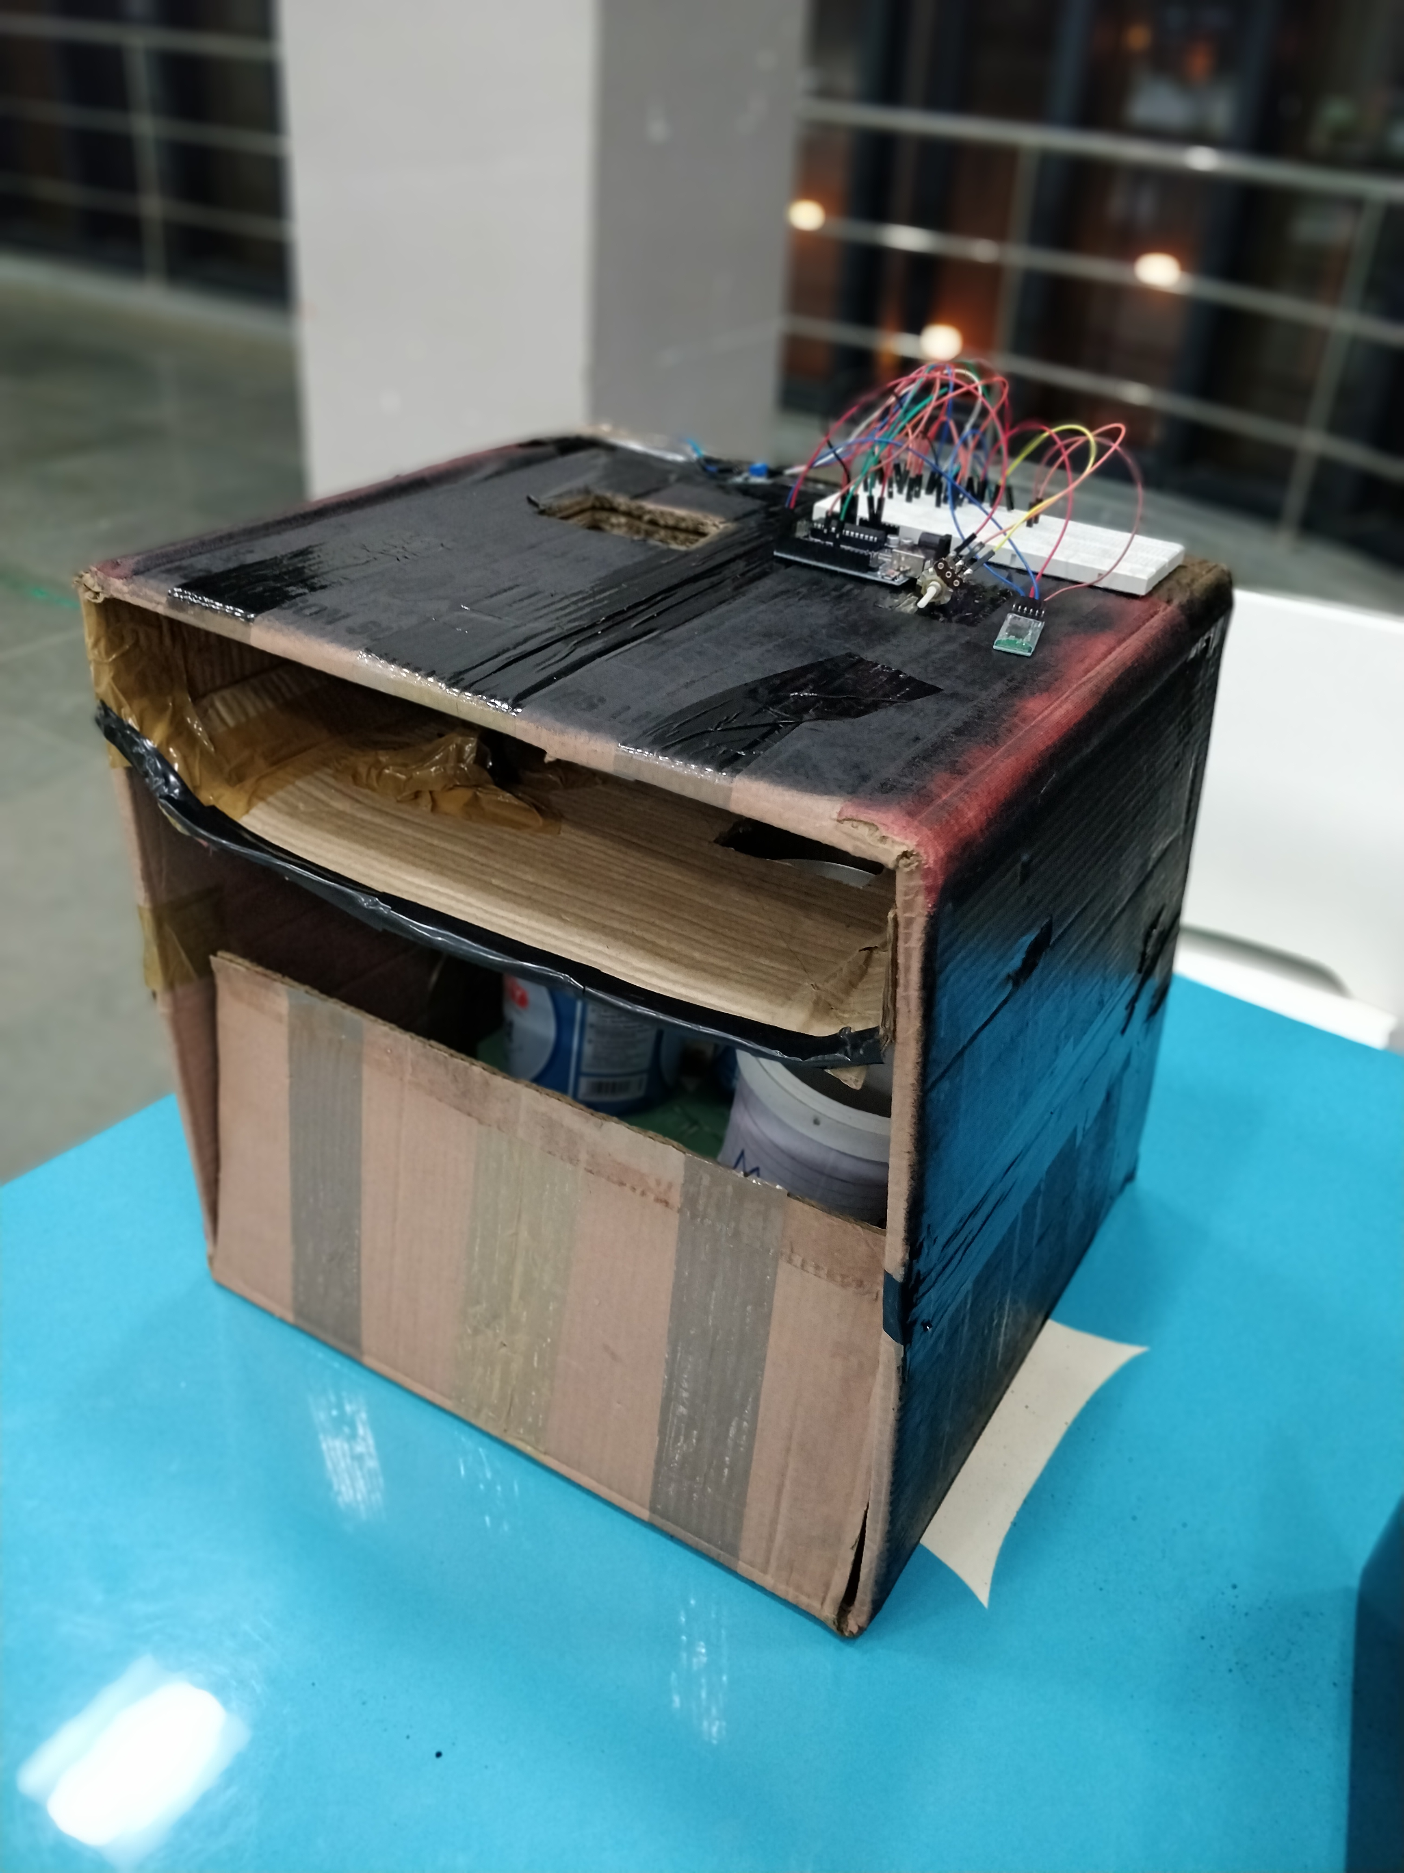
Well, Here’s your solution

Slide 4
The Intelligent Trash can, a solution
The segregation, handling, transport and disposal of waste are to be properly managed so as to minimise the risks to the health and safety of patients, the public, and the environment.
The economic value of waste is best realized when it is segregated. Currently there is no such system of segregation of dry, wet and metallic wastes at a household level.
This project proposes a cheap and easy to use solution for a segregation system at households, so that it can be sent directly for processing.
.

Slide 5
